Slide 1
Vote by Mail Today & Tomorrow
Elizabeth Bergman
Assistant Professor of Political Science
Cal State East Bay
Presentation for New Law, Dec. 2011

Slide 2
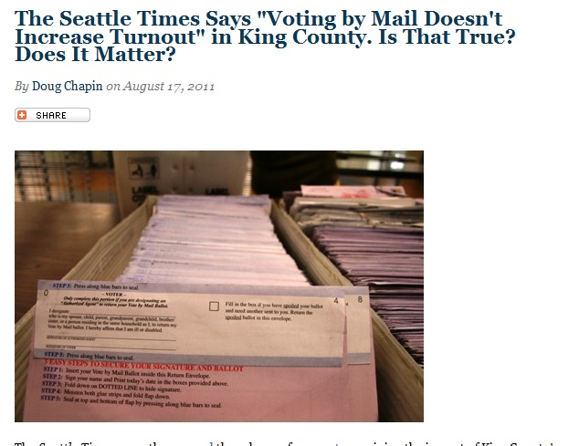

Slide 3
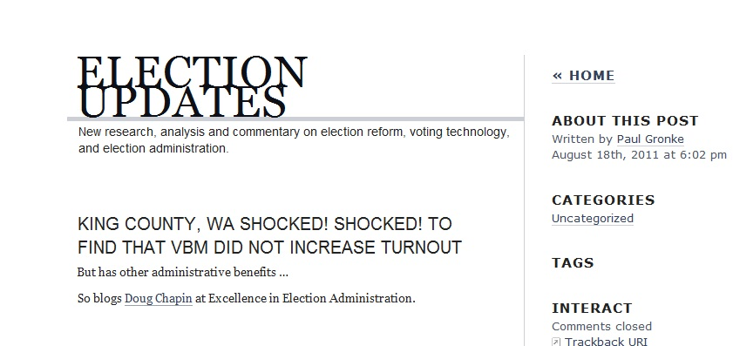
Notes:
.

Slide 4
Data on Vote by Mail turnout
  Early work
  10% positive effect (48 elections Oregon 2000)
      1998: 67% Oregonians approved mail-only initiative
  Most recent work
  3% negative effect in presidential & gubernatorial elections (California 2007)
  7.6% positive effect in low profile local races (California 2007)
    When turnout falls in the range of 10% - 30% of registrants, the marginal voter who might be encouraged to participate by a more convenient method is different from the marginal voter in a general election with a 50% - 70% turnout rate.
  No-excuse absentee ballots: steady turnout first 2 elections, 3rd election a 3% negative effect on turnout (500 counties 2010)

Slide 5
Limitations of early work
Oregon unique
  4 million population, rural, homogeneous
  Surveys
  Did not hold the electoral, political context constant
Aggregate comparisons
  % of turnout in polling places vs. % turnout in mail-only precincts
  No demographic data
Only 1 panel study
  Sample n 811 voters in Oregon

Slide 6
As a result
We know that VBM generally does not increase turnout
  Except in special circumstances
    Low turnout races
  Except in special locations
    Oregon
We do not know why
  Campaign spending?
  Campaign competitiveness?
  Demography of voters
  Role of election officials

Slide 7
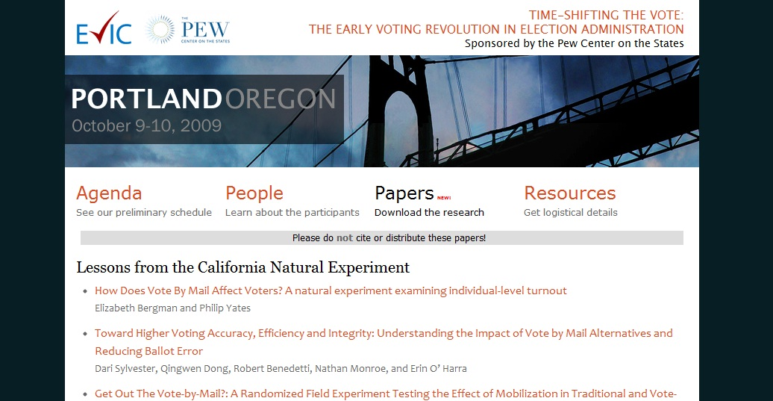
Pew funded research
http://www.earlyvoting.net/conference09/protected/papers.php

Slide 8
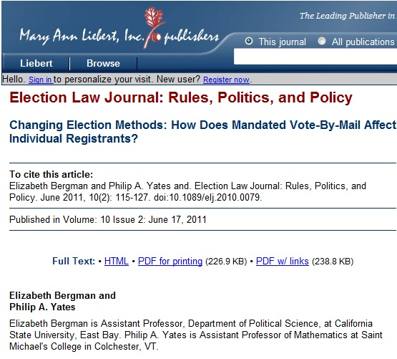
Bergman analyzed the behavior of 97,381 individual voters across four elections from 2006 to 2008 and found that when all-mail balloting was implemented, the estimated odds of an individual registrant voting decreased by 13.2%.
Panel study:
We followed the same voters across 4 elections.

Slide 9
Some notable findings:
Political context is significant
For all mail-only voters:
34% more likely to vote in General than primary during presidential election
  This overcomes the negative effect of mail-only
5.6% more likely to vote in General than primary in midterm/gubernatorial election
Spending & competitiveness were significant contributors to likelihood of turnout

Slide 10
Time:
Repeat VBM experience was not significant
Repeated exposure to mail-only balloting on the same voter did not have a positive effect on their likelihood to turnout in the next election.

Slide 11
Electoral context:
Communication significant
Mailings from election officials
Findings indicate that each additional communication improves the odds of voting by 3.94%
  A voter receiving 4 separate communications wipes out the negative odds
  A voter receiving 5 separate communications is 4.05% more likely to vote than a precinct place voter who got 0 mailings.
It is likely that multi-lingual VBM mailings could help, but we did not test that.

Slide 12
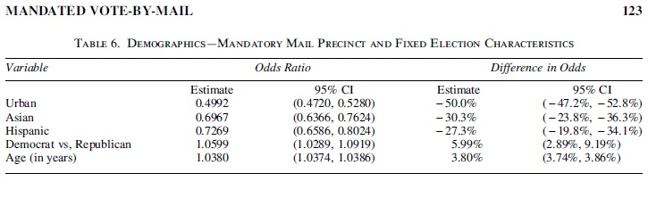
Key demographic indicators
California Note:
43% of the Latino population is limited-English proficient (LEP)
39% of the Asian population is LEP
Notes:
VRA section 203, 25 counties, 4 in the study counties:
Alameda (Chinese, Spanish)
Fresno (Spanish)
San Mateo (Chinese, Spanish)
Santa Clara (Spanish, Chinese, Filipino, Vietnamese)

Slide 13
Conclusion
Method does not alter behavioral predilection
  Convenience is not a dealmaker
VBM accents individual-level factors that have traditionally challenged turnout
Notes:
How I vote does not motivate whether I vote

Slide 14
End

